Slide 1
prometheus and grafana
Mohamed Islam

Slide 2
AGENDA
1 - Introduction
2 - Prometheus
3 - Grafana
4 - How They Work Together
5 - Real World Example
6 - Summary

Slide 3
Introduction
The Concept: Monitoring a complex app is like monitoring a patient
The Patient: Your Website or Application.
The Medical Monitor (Prometheus): It stays connected to the patient,
constantly "pulling" vital signs like heart rate (CPU usage), blood pressure (Memory).
The Doctor’s Dashboard (Grafana): The big screen at the nurse's station.
It doesn't collect the data itself; it just displays the Prometheus data in a way
that allows a doctor to spot a "heart attack“(system crash) before it happens.

Slide 4

Prometheus
The Brain and the Database
  Key Function: It is a Time-Series Database. It stores data points indexed by time.
  The "Pull" Model: Unlike other tools, Prometheus goes out and "scrapes" (asks for) data from your apps at set intervals (e.g., every 15 seconds).
  PromQL: Its own "Query Language" used to calculate things like "What was the 95th percentile of response time over the last 5 minutes?"

Slide 5

Grafana
The Face of the Operation.
  Key Function: A visualization engine that connects to almost any data source (Prometheus, MySQL, ElasticSearch).
  Interactive: You don't just look at a static image; you can zoom into specific time ranges, filter by server name, and set visual thresholds (e.g., turn a graph red if CPU > 90%).
  Alerting: While Prometheus detects the problem, Grafana can send a sleek notification to Slack or Email with a picture of the failing graph.

Slide 6
How They Work Together

Slide 7
How They Connect
The Workflow:
Exporters: A small "agent" (like Node Exporter) runs on your server to expose metrics at a URL.
Prometheus: Regularly visits that URL, grabs the numbers, and saves them.
Grafana: Connects to Prometheus as a "Data Source." You build a graph by writing a small piece of code (PromQL).

Slide 8
Real World Example

Slide 9
Website Monitoring
The Goal: Proactively monitor our public websites to ensure they are fast, secure, and reachable.
We monitor:
-Connectivity: Ping and DNS lookup times.
-Security: TLS/SSL version and Certificate Validity (Don't let your HTTPS expire).
-Performance: Probe duration (How long the page takes to load) and HTTP Version.
-Reliability: HTTP Status Codes (200 OK vs. 404/500 errors) and Redirects.

Slide 10
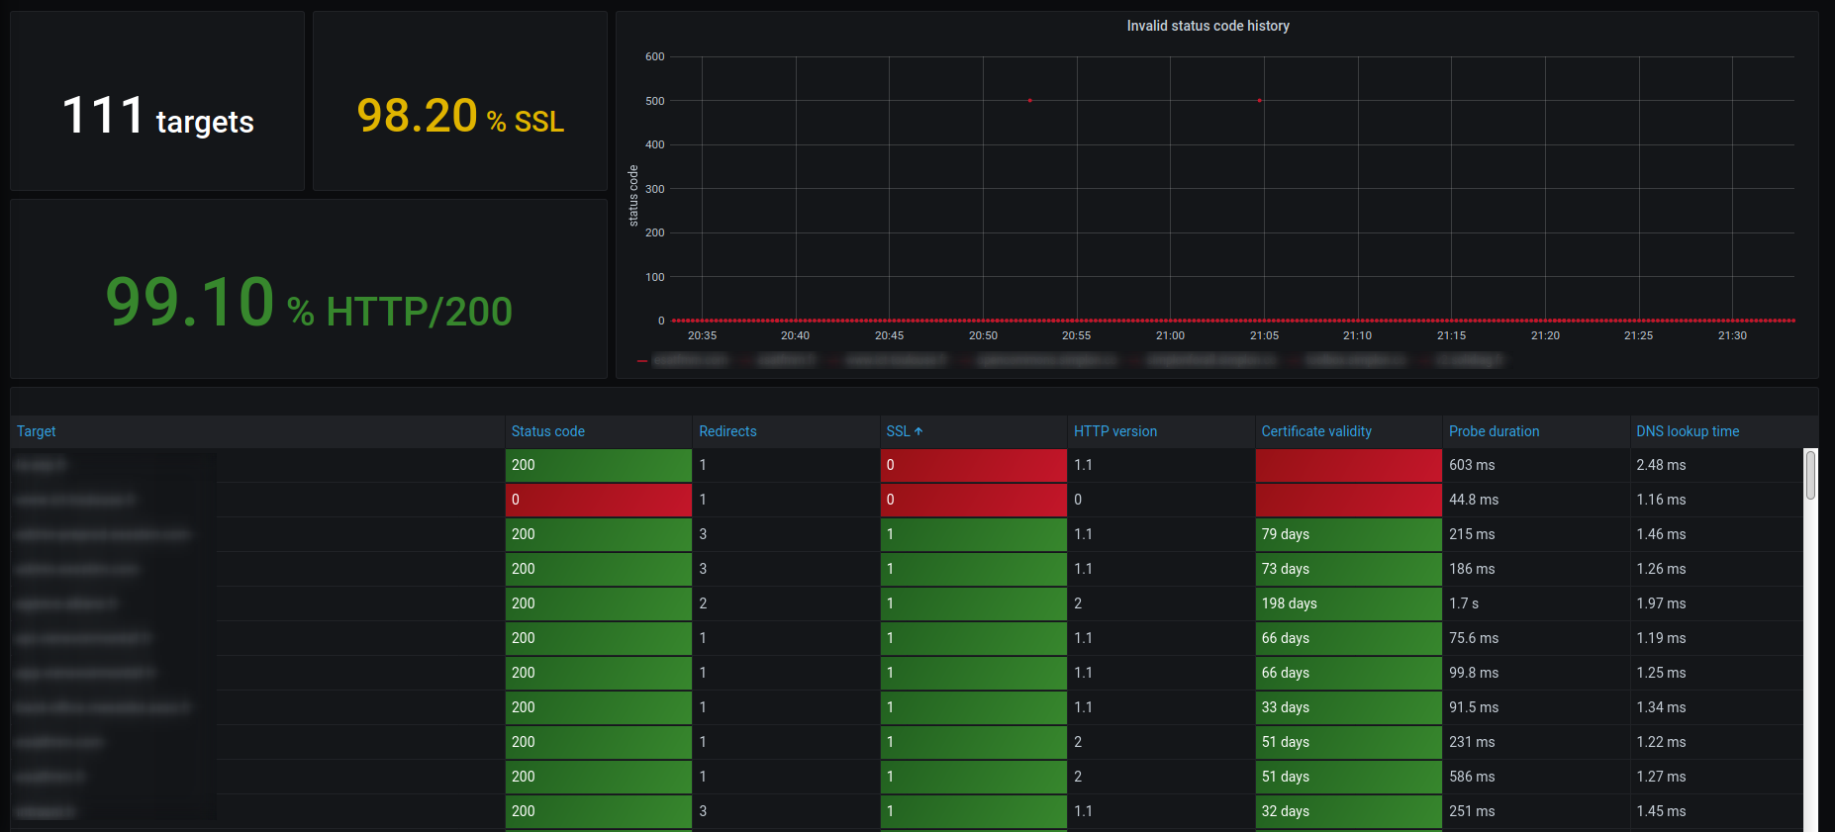
The "Global View" Dashboard
The Executive Summary: Instead of looking at 100 different sites, we use Grafana to aggregate the data into an "Overview" panel.
Total Targets: showing how many sites we are monitoring.
Success Rate: A big green gauge showing the Percentage of HTTP 200 status codes.
Security Health: Percentage of targets using valid SSL/TLS.
Uptime Trends: showing availability over the last 24 hours, 3 days, and 7 days.

Slide 11
The Power of PromQL
To make these dashboards work, we use PromQL (Prometheus Query Language)
The Result: Prometheus receives a list of numbers (metrics) like:
Query Type | What it tells you | Business Value
Predictive | Days until SSL expiration | Prevents "preventable" outages
Reactive | Lists non-200 status codes | Tells you exactly what to fix now
Analytical | Overall Uptime % | Measures long-term reliability
probe_success 1(The site is up)
probe_http_status_code 200
probe_duration_seconds 0.15

Slide 12
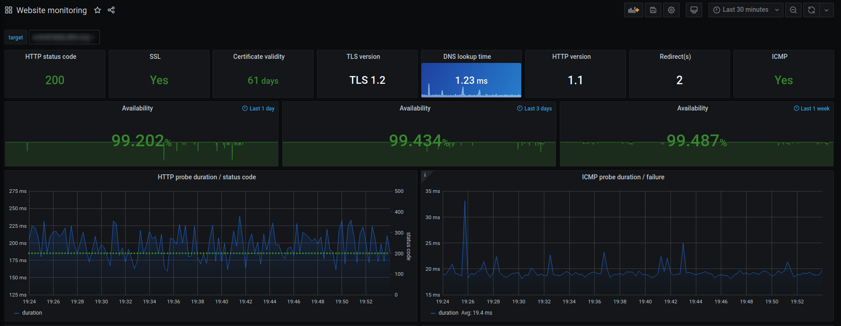
Technical Misc & Testing

Slide 13
Summary & takeaways
Prometheus is the "Back-end" (the brain that gathers and stores data).
Grafana is the "Front-end" (the face that shows beautiful charts).
Together: They turn raw, confusing numbers into actionable business decisions.
By combining Prometheus for data collection and Grafana for the dashboard, we don't just 'hope' our website is working. We have a 24/7 automated 'Pulse Check' that tells us exactly when a certificate is about to expire or when a page starts loading too slowly.

Slide 14
THANK YOU

